Slide 1
Well Watch
Well Watch Integrated Data Management System

Slide 2
Capabilities & Main Features
Easy-track file history
Automatically Determine received reports:
Hi-Speed Data Base Search.
contractor/contract/well name/file type/report date
Unique & consistent parent/source link with several attachment(s)/reference(s)
Alarm system for missing vital information & files
History log of all log in and activities are recorded for admin:
Login session, Viewed files, Downloaded Files, … .
Read only feature of files secures the files / prevent manipulations
Customized access levels
All software commands are available based on user access level.
“User Friendly Interface”, (same as windows explorer.)

Slide 3

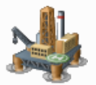


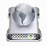



Well-Watch
Modules & Relations
Some document/data from user
Dispatcher.
Main Module
Change & Claims.
Invoice.
Upload directly
Automatic Archive
Auto-Dispatch
Archive Viewer. (As storage base)
Personnel Evaluation.
Internal Message.
Final Users

Slide 4

Dispatching
Conventional:
Each rig sends reports/emails directly to final users.
Each rig must update recipient list occasionally.
In office one/more person(s) must archive and categorize all received files.
Higher Accuracy
Less man-power
Continuous operation
Risk Level
E-Mail
Well-Watch (Dispatcher):
Rigs emails reports to “Data-Master” email center, and “Data-Master” will distribute them to final users automatically.
Distribution list defined and modified by administrator at Tehran office.
Also well-watch will archive and categorize received reports automatically 24-7.
Well-Watch:
Risk Level
Dispatch
E-Mail

Slide 5


Archiving
Direct access to all files by users. (IT department only defined 3 Access level on Windows Explorer).
Data subject to loss or damage.
No log of activities including; read/write/delete.
Slow Searching – 1 level of searching
Multiple parent folder for some files
Windows
Pre-determined flexible access level for each user.
Limited administration access for upload, modification, move, deletion to recycle bin of files.
No permanent deletion of files; only hides the files, can be restored from internal recycle bin.
Log all file activities and users; login/read/save/export/delete.
Well-Watch:

Slide 6
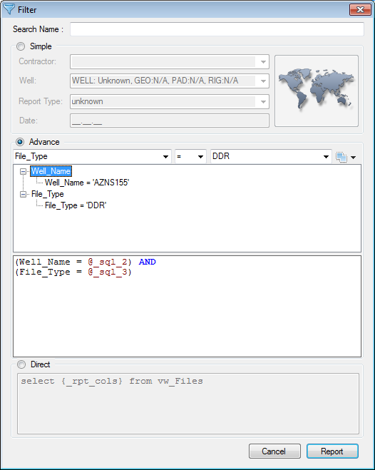
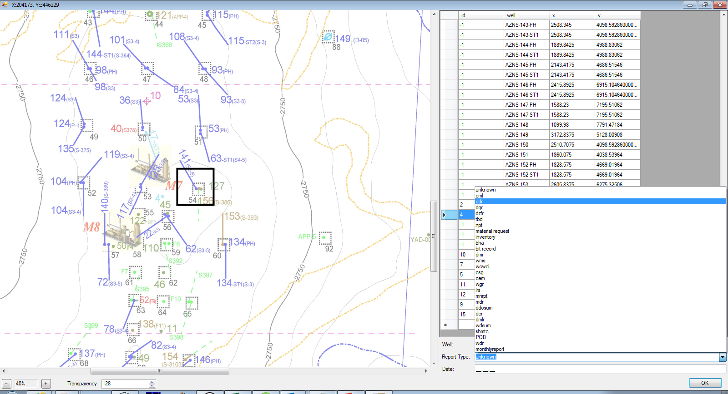
More Features
Search Modules
4 search modules:
Simple
2D map
Advance
Direct SQL
1. Simple Search
2. 2D Map Search
3. Advance Search
Can make complex criteria
4. Direct Search
Will use SQL commands
Search well on 2D map

Slide 7
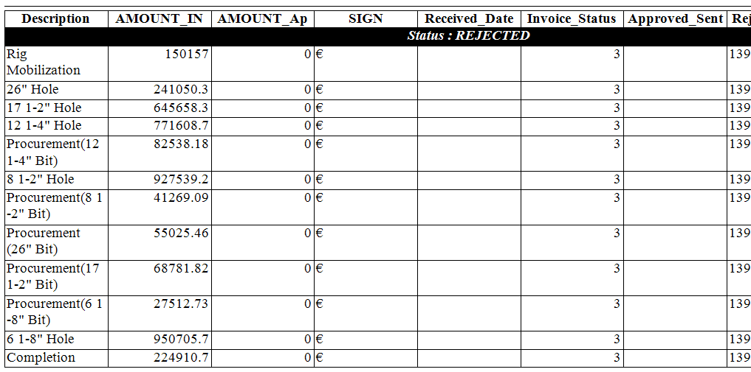
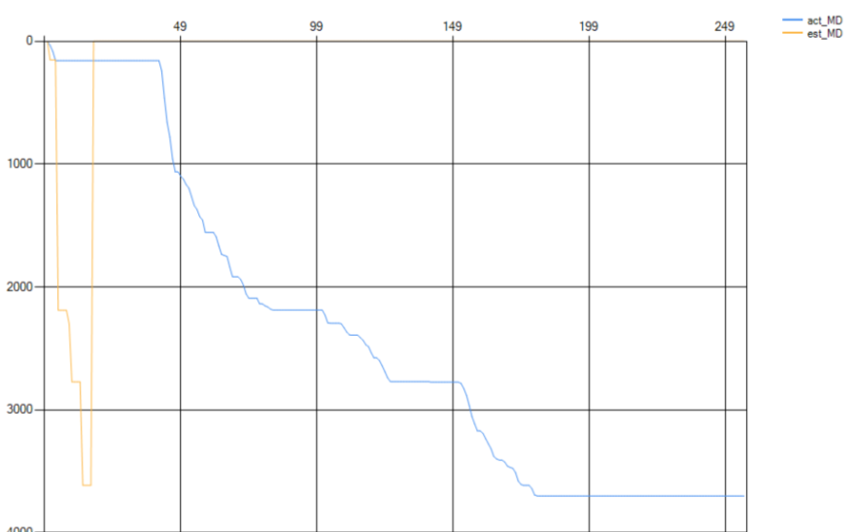
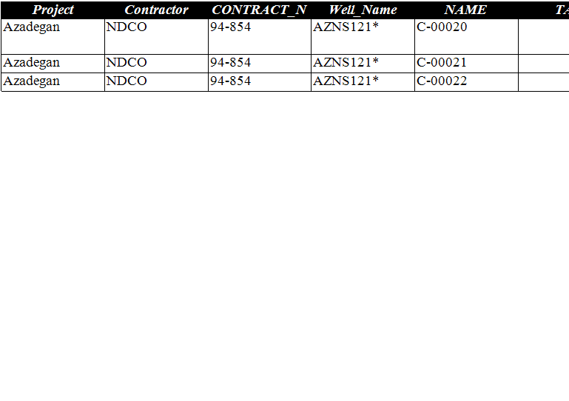
More Features
Management Dashboards
#156’s Invoices
#156’s Time vs depth
#156’s Claims (list)

Slide 8
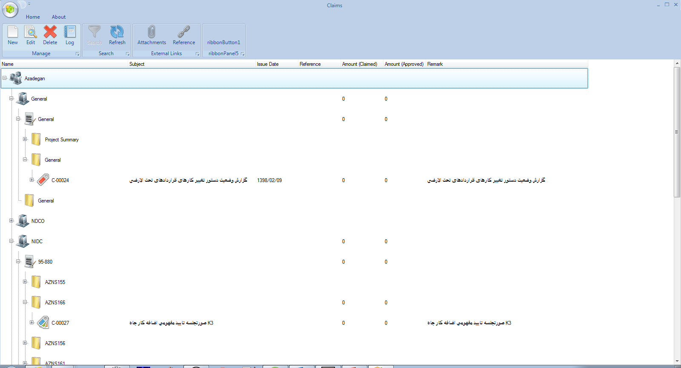
Change & Claim
Upload all relevant files, letters and MoMs to database
Trace the status of each case; started, ongoing, closed
Management reporting on each project overally including contract management
Independent from individuals

Slide 9
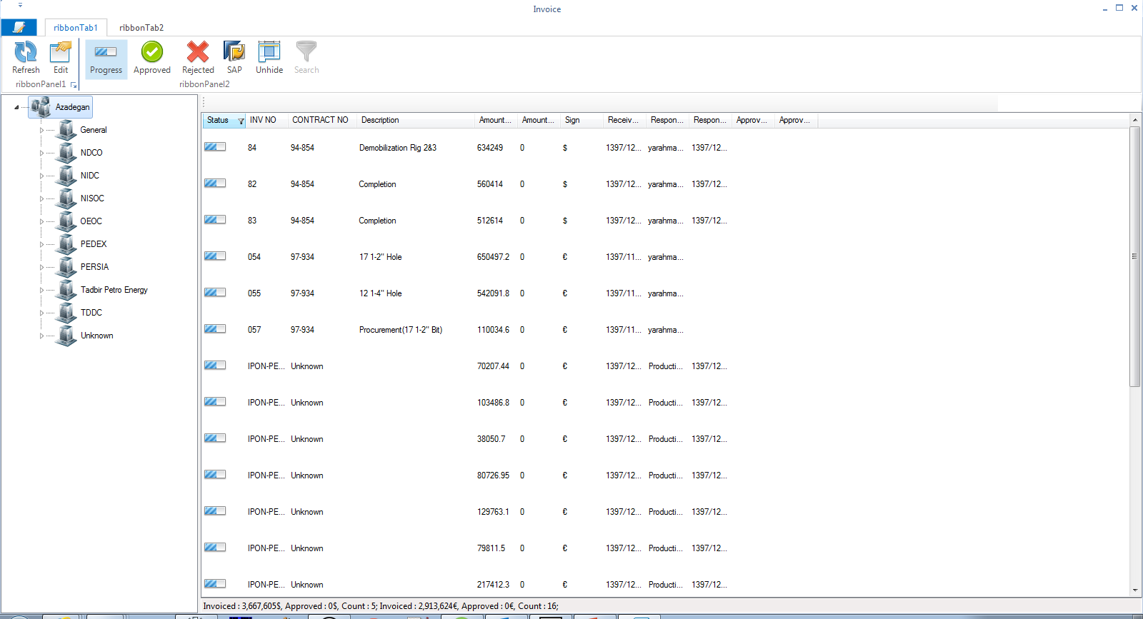
Invoice Tracking
Upload all relevant files, WPAs, supporting documents to database
Trace the status of each invoice; approved, ongoing, rejected
Management reporting on each project overally including contract ceiling
Independent from individuals

Slide 10
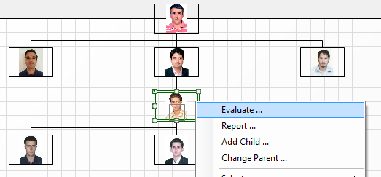
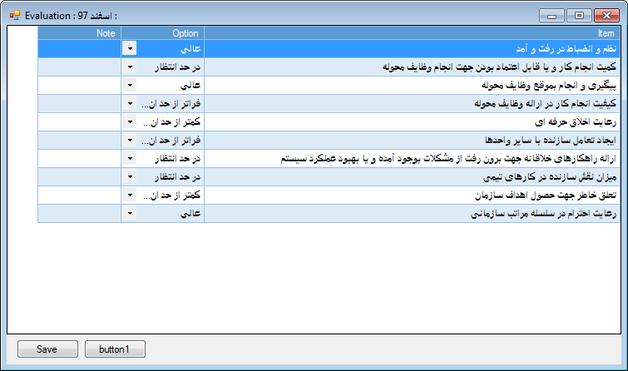
Personnel Evaluation
Evaluate individual performance monthly
Record all evlauations
Generates different reports
Follow pre-determined hirearchy

Slide 11
Archive viewer

Slide 12
Well Archive as the data base supports all modules
Provides integration between files, SoWs, invoices, claims & contents of different reports of each well or contract
Source
Generate Reports
Send Reports
Server
Users
Use Reports
Upload Files
Archive Reports
(Dispatch Mails)

Slide 13
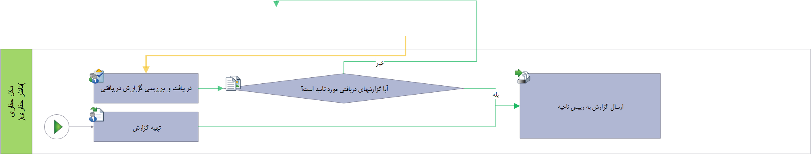
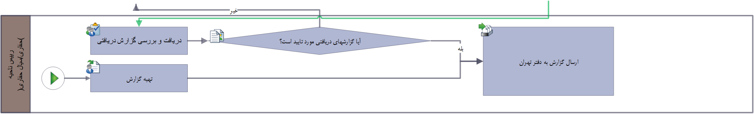
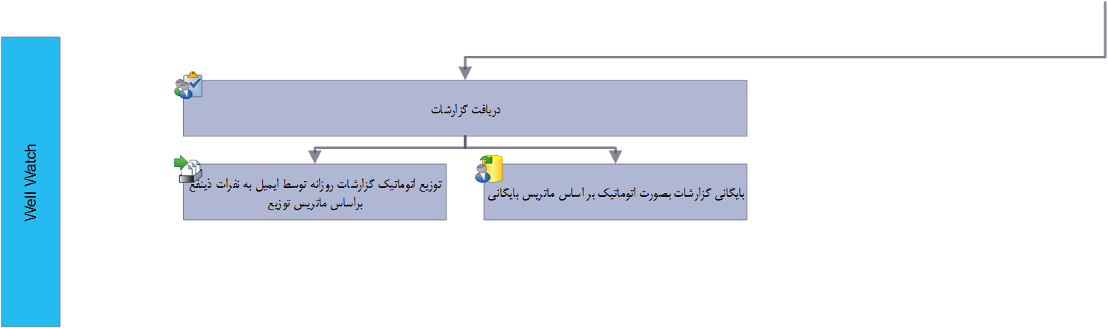
Work Flow

Slide 14
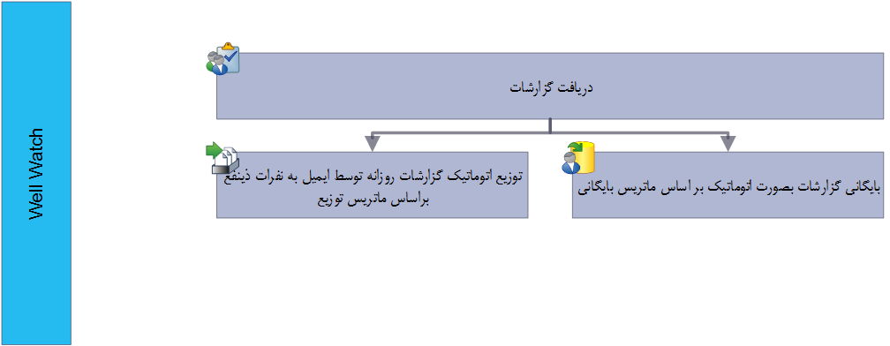
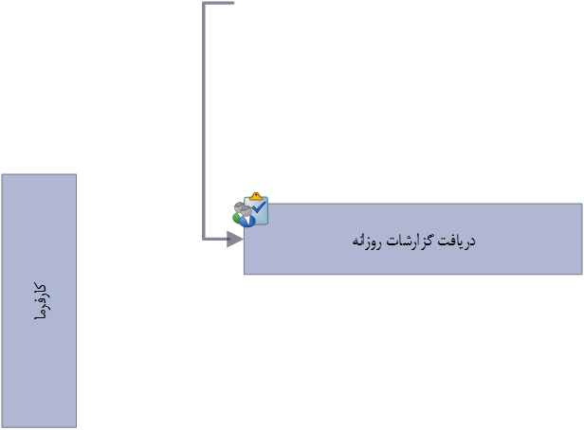
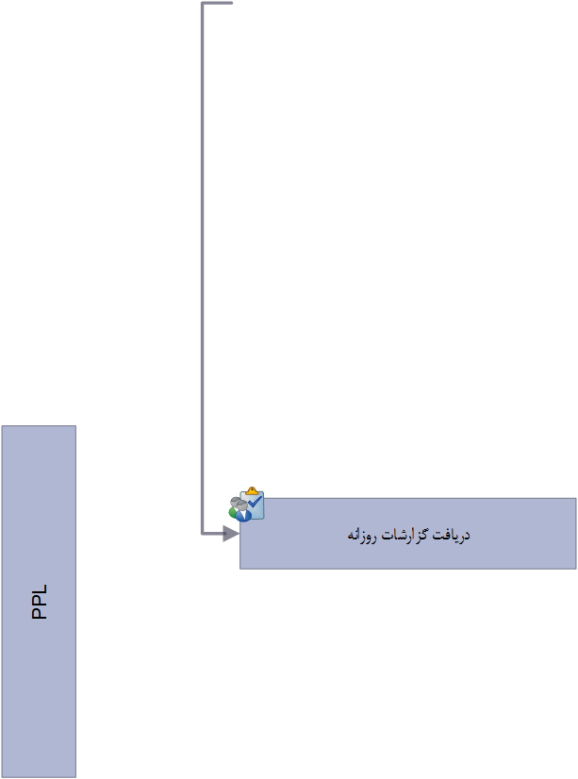
Work Flow

Slide 15
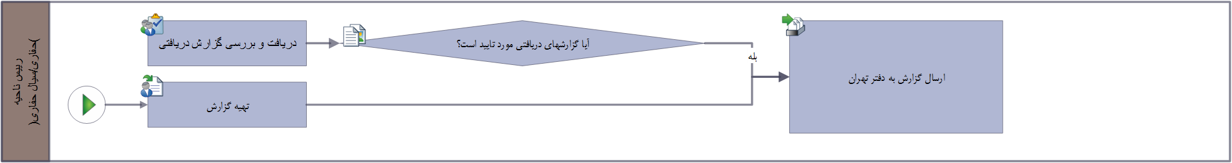
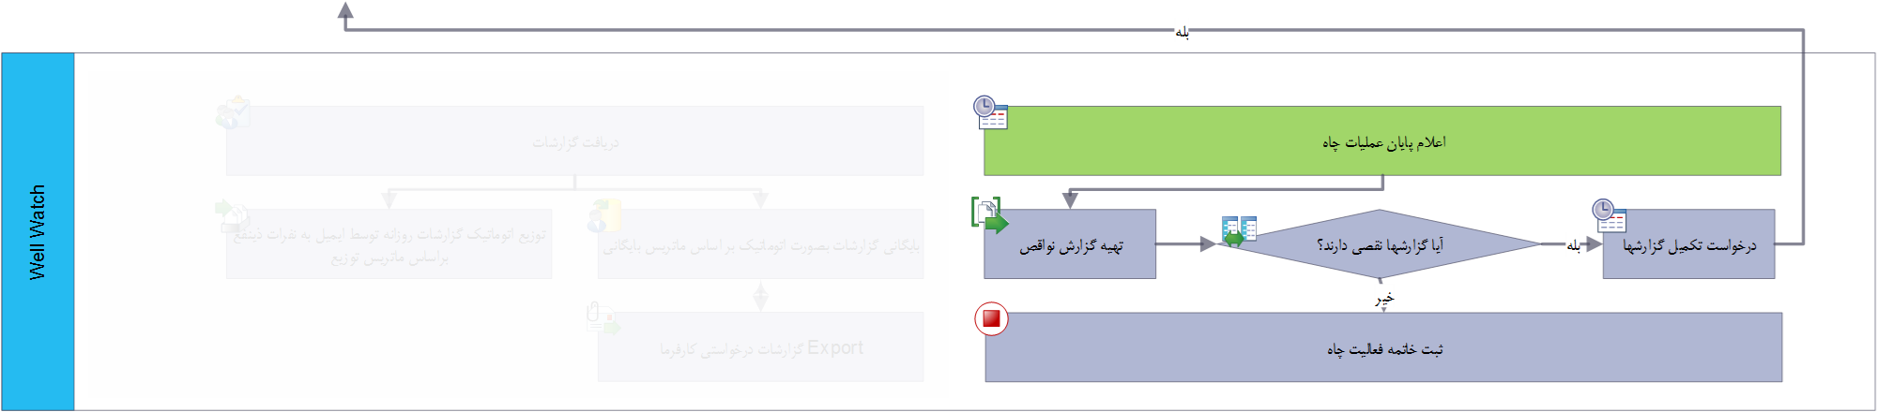
Release Rig

Slide 16
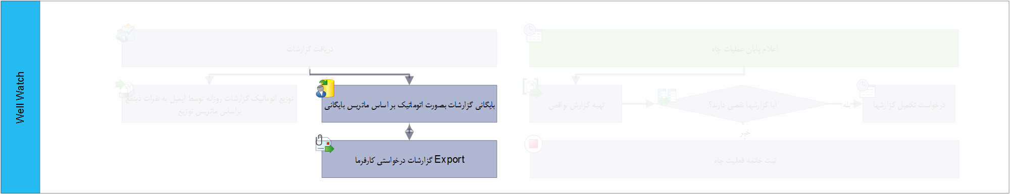
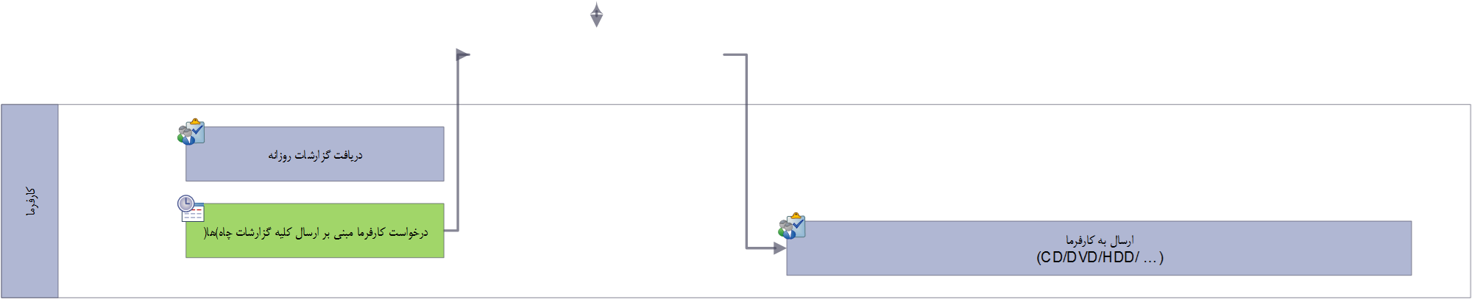
Export

Slide 17
